Slide 1
Word Processing
Grade 12 CAT

Slide 2
Term 1- Bookmarks
To insert a bookmark → select the text that must be bookmarked
Insert ribbon →Bookmark
Type a name and
Press Add
To delete press the second (Delete) button.

Slide 3
To find a bookmark
CTRL +G
Select bookmark 4th option
The available bookmarks will be displayed in the textbox
Select which one you want and
Select Go To

Slide 4
Hyperlinks
Word is able to hyperlink to:
A bookmark in the document
Another file (does not have to be a Word document)
A web page
A new document
An email address
You can display text when people hover on the hyperlink

Slide 6
Cross Reference
This is similar to a hyperlink in that you can tie in to a word or picture in the document
You can various reference types
And you can decide what you want to display e.g. page number
You can also choose to hyperlink to the original

Slide 7
Showing reference types
What do you want to display

Slide 8
Reviewing and tracking changes
We use this when we are sharing a document between people
Pages 184 to 187 deals with this topic

Slide 9
Electronic Forms
If you had decided to distribute your survey using electronic forms this section would be very beneficial because you could import the data directly from the form to a Spreadsheet.
This prevents you having to capture the data yourself.
You would use legacy forms controls

Slide 10
Mail Merge
This was done last year. As long as you work across the mailings ribbon there should be no problem.
Sort/filter the
records/fields
First button to activate
Final Step
Find the file for the names
What to insert

Slide 11
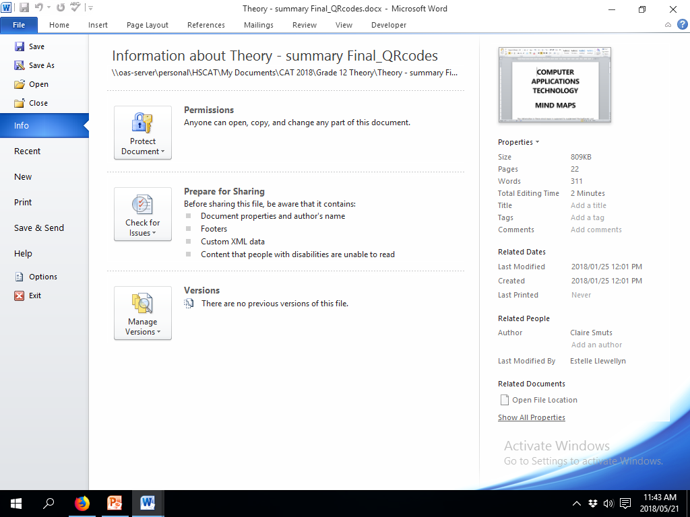

Slide 12
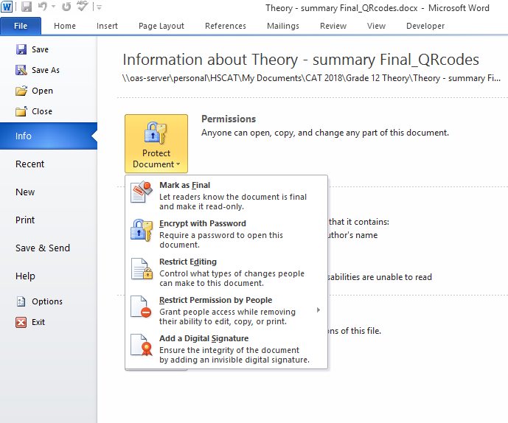

Slide 13
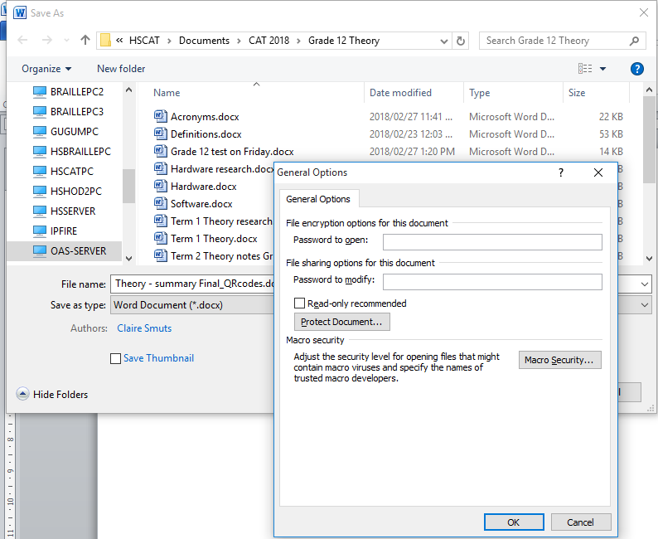

Slide 15
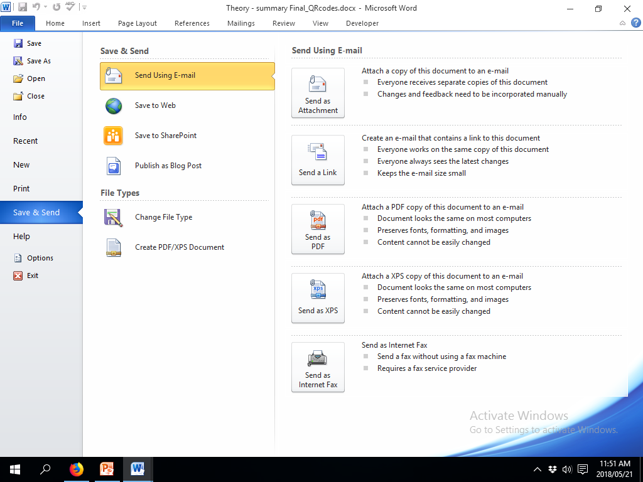

Slide 16
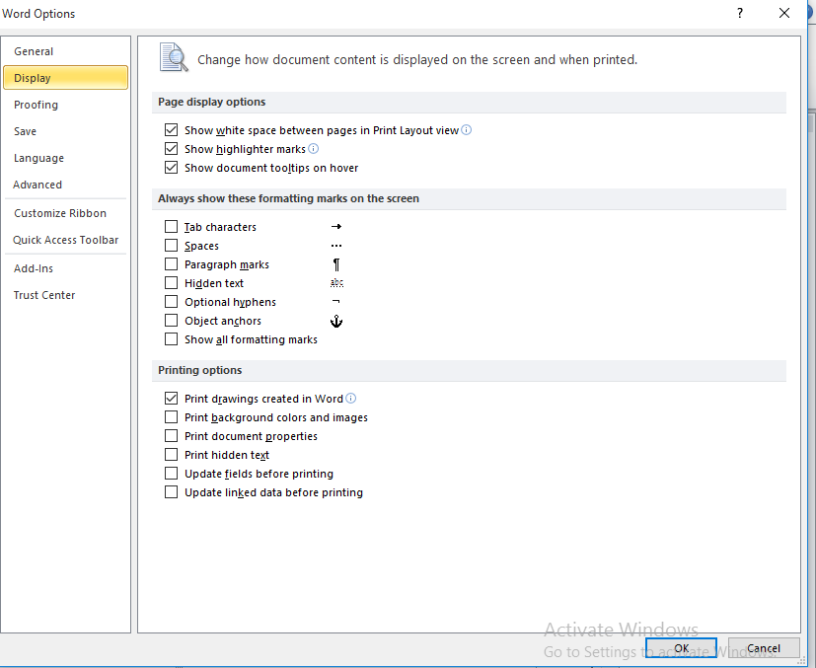

Slide 17
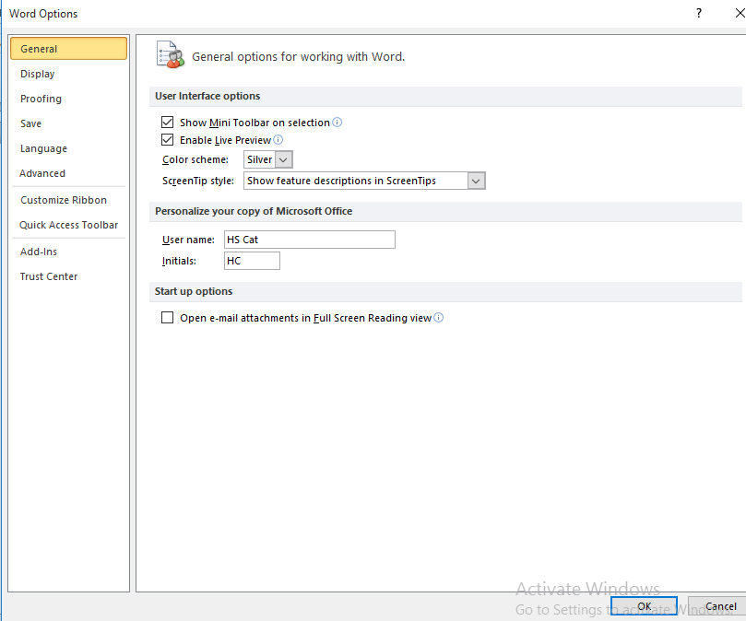

Slide 18
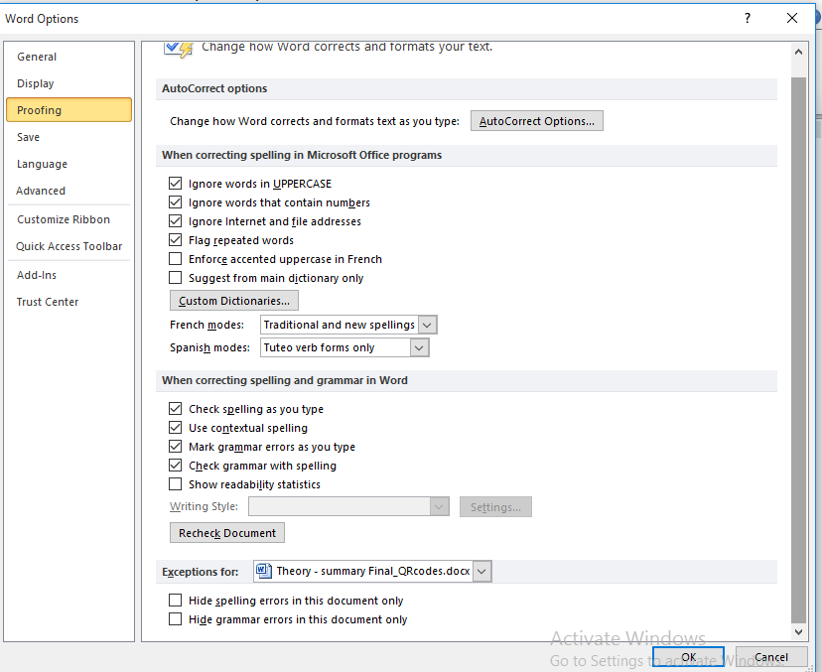

Slide 19
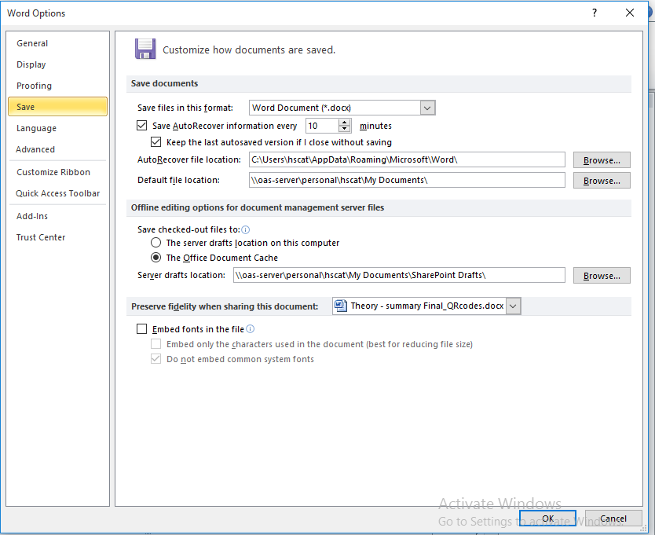

Slide 20
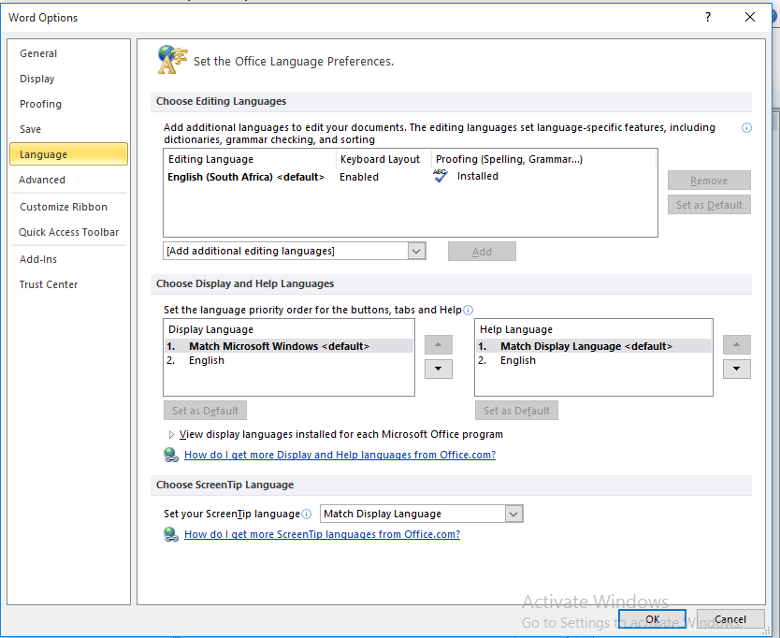

Slide 21
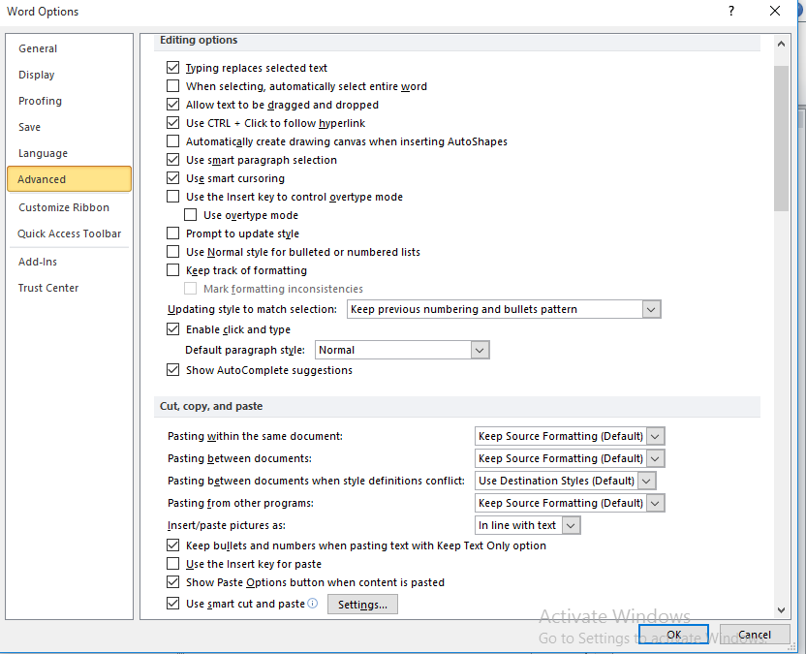

Slide 22
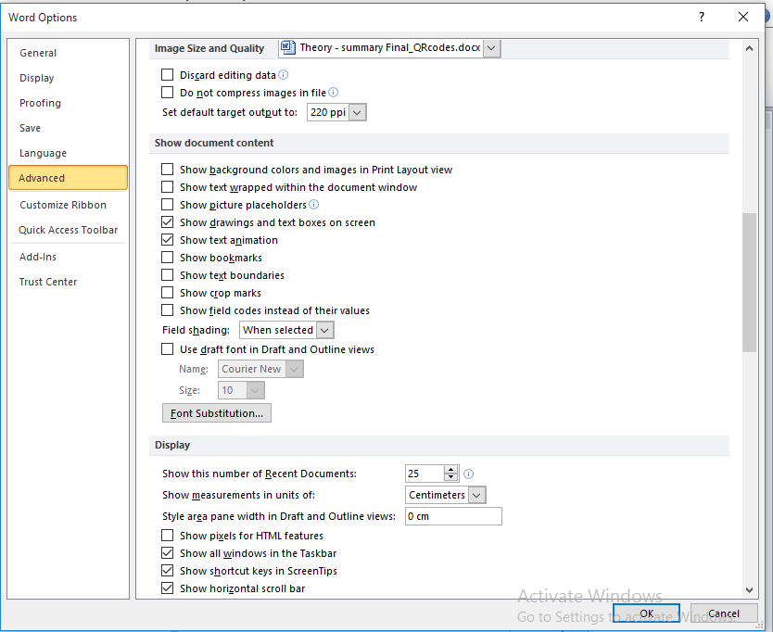

Slide 23
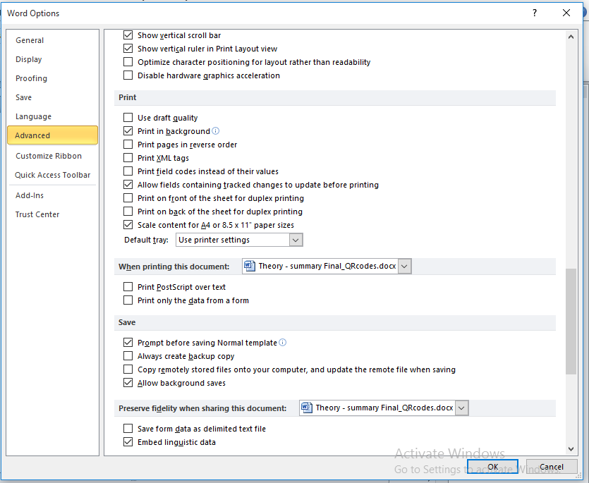

Slide 24
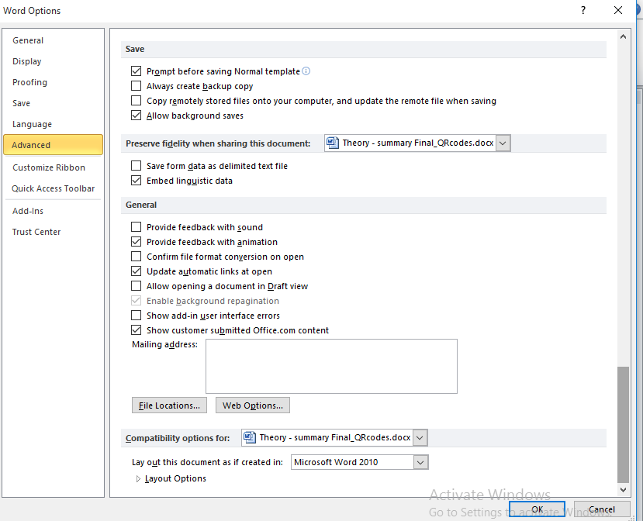
Done

Slide 25
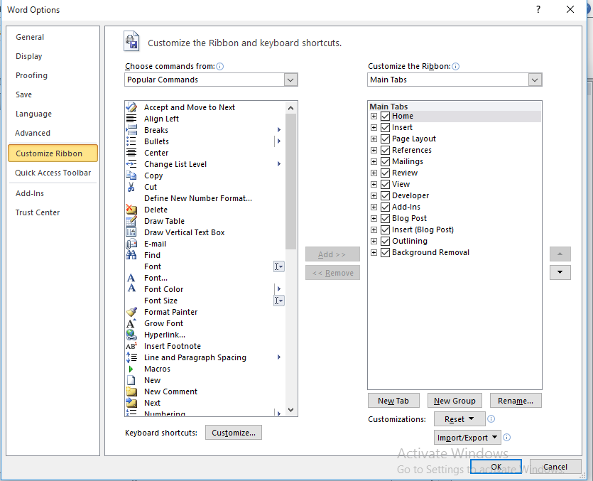

Slide 26
